Slide 1
Massive Open Online Courses (MOOC)

Slide 2



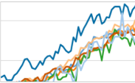



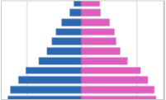



MOOC Data Project Architecture
www.edX.com
*.csv
Instructors
*.py
Ingest Module
Administrator
Web-Dashboard
*.CSV File
Store
Computed Data Store
AWS S3
PostgreSQL
*.py
Cleaned
Data Store
*.py
Extract, Transform, Load
AWS RDS - PostgreSQL
Compute & Model

Slide 3
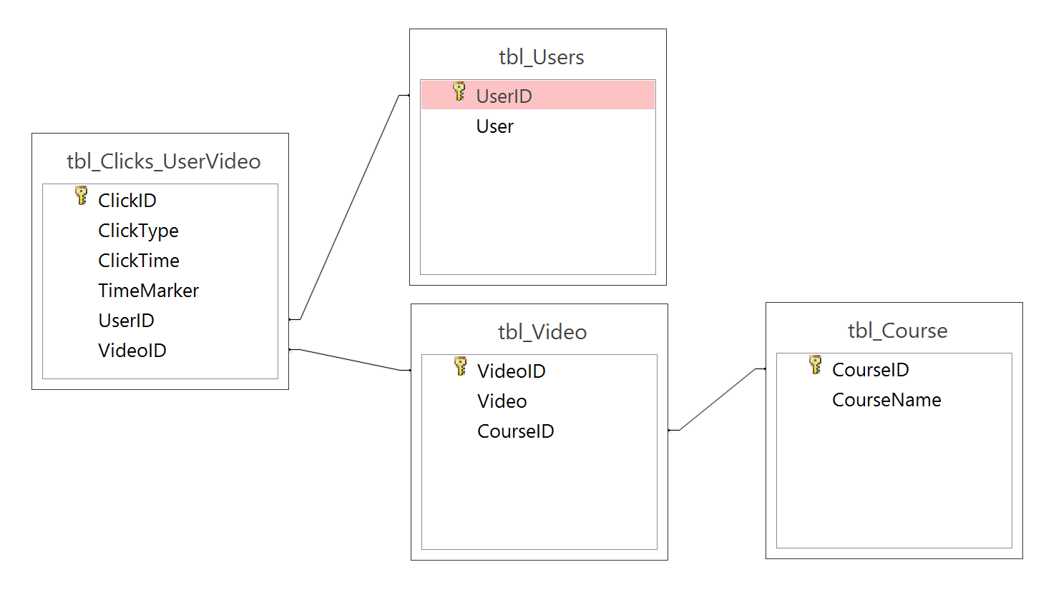
Entity Relationship Diagram (ERD)

Slide 4
